Slide 1
Inha University in Tashkent
Theme 5: Western Philosophy in Middle Ages

Slide 2
Outline:
Characteristic features of the Period
The Basics of Christianity
Western Philosophical Schools and Traditions of Medieval Period
Scholars on Theology and Philosophy

Slide 3
Characteristic feature of the Period
Medieval period in Europe begins from the fifth century AD and lasts till the 15th century.
One of the significant characteristics of the period was the religious impact on all aspects of human life.
Firstly, Christianity was formed and developed as a state religion and ideology. Secondly, the Inquisition has become a priority.
Inquisition is the institution of the Roman Catholic Church for the search and punishment of heretics and other enemies of the Catholic Church. Although this organization was created in the early 13th century to combat heresy in France, its origins should be seen in earlier medieval church actions directed against heretics.

Slide 4
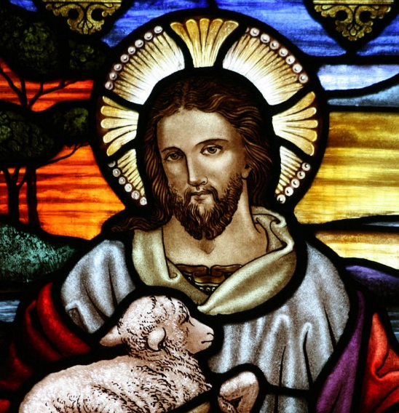
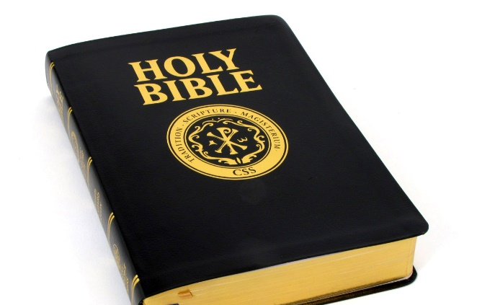
The Basics of Christianity
Christianity (from the Greek Christos - literally: the anointed one) - is one of the world religions, named for its founder Jesus Christ.
Jesus Christ:
God-man who descended from heaven to earth
accepted suffering and death for the salvation of people
then arose and ascended into heaven.
Christianity arose in the early 1st century, and in the 4th century became the dominant religion of the Roman Empire.
It has three main branches: Catholicism, Eastern Orthodox and Protestantism.
A common feature that unites Christian belief and sects is faith in Jesus Christ as a God-man, the savior of the world. The main source of the religion is Bible, especially the New Testament.

Slide 5
Impact of Christianity
Christianity influenced on the philosophical thoughts of medieval period in Europe.
During the period, several philosophical schools and traditions emerged:
Gnosticism
Apologetics
Patristics
Scholasticism

Slide 6
Gnosticism
Gnosticism \nä-stə-ˌsi-zəm\ (from the Greek gnostikos - the knower)
the religious dualistic doctrine of late antiquity (1-5 centuries)
It included some aspects of Christian doctrine, popular Greek philosophy and Eastern religions.
The term does not appear in ancient sources and was first used by Henry More in the 17th century.

Slide 7
Gnosticism
Gnosticism claimed a "true" knowledge of God and the ultimate secrets of the universe.
The emergence of Manichaeism is associated with Gnosticism.
Gnosticism was based on dualism.
Gnostics recognized the Supreme Being, or the Supreme Spirit, on the one hand, and matter on the other. The Supreme Being, they represented an independent, and beginning of light and goodness, the source of spiritual life.
Matter, on the contrary, is represented in the Gnostics as an independent beginning of material life and evil. According to their doctrine, matter is always a form of evil.
Therefore, they believe that God can never create the material world
Gnostics were guilty of heresy by Christian clergies.

Slide 8

Apologetics
Apologetics /əˌpɒləˈdʒɛtɪks/ (from the Greek apologeomai – “protect”) is a collective name for early Christian writers-philosophers
Apologetics defended the principles of Christianity in their writings from criticism of non-Christians, pagan rulers and scientists
Apologetics was formed in the 1st – the 3rd centuries.
In their messages, the apologists substantiated the advantages of the moral principles of their doctrine, the possibility of adopting Christianity as a state religion.

Slide 9

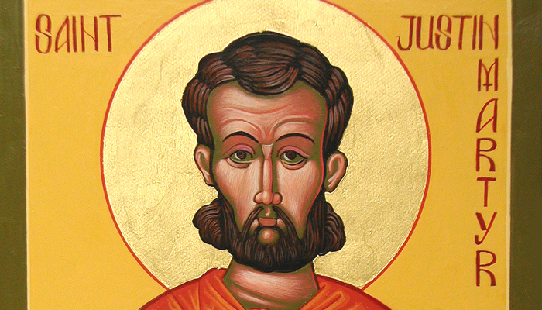
Apologetics
The works of apologetics are clearly seen in two traditions:
denial or refusal
confirmation
They have, in the first place, denied the allegations made by the polytheists to Christianity - unreasonable actions and luxury.
Apologetics confirmed the purity of Christianity
One of the great representatives of apologetics was Saint Justin (Martyr)
He is the author of such works – “First Apology”, “Second Apology”, and “On the Soul”

Slide 10
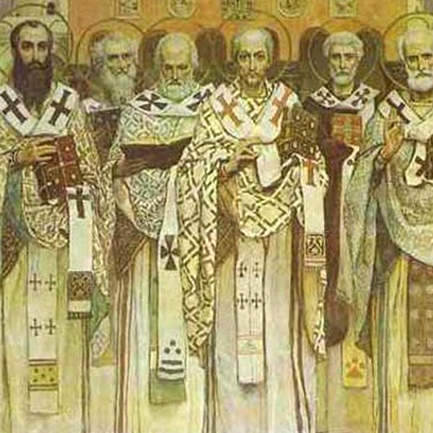
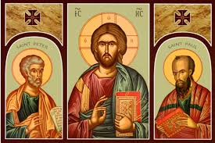
Patristics
Patristics or patrology [Greek pater (patros) - father] - the tradition of philosophic-theological thought of the 2-8 centuries
Associated with the activities of early Christian authors of the Church Fathers.
Church Fathers - honorary title, used from the end of the IV century to a group of prominent church figures and writers of the past, whose authority had a special weight in the formation of dogmatics, the hierarchical organization and worship of the Church, and the compilation of the canon-the list of the Holy Books of the Bible.
They set out the principles of Christian theology and philosophy. The teachings produced by the Church Fathers became the foundations for the Christian religious view and attitude. Patricia made an enormous contribution to the formation of the ethics and aesthetics of the late-antique and medieval society.

Slide 11
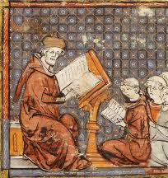
Scholasticism
Scholasticism (from the Greek scholastikos - school, scientist), a type of religious philosophy
Characterized by a combination of theological-dogmatic premises with a rationalistic methodology and an interest in formal-logical problems.
Scholasticism has received the greatest development in the Western Europe in the Middle Ages.
Those who teach in the Palace of Great Charles [ʧɑːlz] (742-814), or teachers in the Court school, are often called scholastics. Scholars of the Middle Ages, who implemented philosophy in studying the religion, also called Scholastics.
Ancestors (and later companions) of Christian scholasticism were Islamic Ilm al-Kalām and Jewish Kalam.

Slide 12
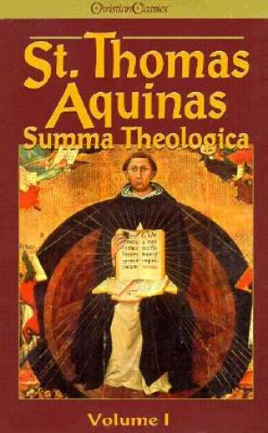
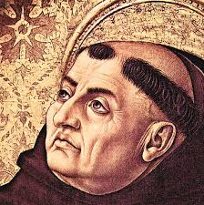
Thomas Aquinas
Thomas Aquinas (1225-1274) is a major representative of moderate realism.
Thomas Aquinas tried to unite Aristotle's philosophy with theology.
At the same time, he was in the position of moderate realism and was the greatest figure in the scholasticism.
In his opinion, the thought of natural philosophy and the logic of Aristotle can reach the truth about the existence of god.

Slide 13
Heritage of Thomas Aquinas
His major work – “Summa Theologica” consists of 3,000 articles dedicated to covering 600 issues.
It is a systematic explanation of theology. The first part of the "Summa Theologica" discusses the existence of God. The second part describes "Moving Towards God“
According to Aquinas, the world looks like as a hierarchical ladder.
The Earth is at its bottom, there are 4 elements which constitute all bodies.
The human soul occupies a place between the God and the material world. At the top of a secular society, the pope is standing as a ruler of divine state. As he moves from the Earth, he becomes divine. There is an angelic world above the planet Earth.

Slide 14
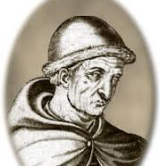
Roger Bacon
Roger Bacon (1214 - 1292), also known as the Amazing Doctor (Latin Doctor Mirabilis), English philosopher and naturalist, professor of theology at Oxford. He was engaged in mathematics, chemistry and physics.
In philosophy, Bacon did not create a new teaching, but he criticized the methods and theories of his time. The first spoke against scholasticism and spoke sharply about the then great authorities (Albert the Great, Thomas Aquinas, etc.). His work "Opus majus" (1268) carries the idea of the uselessness of abstract dialectics, the need to study nature through observation and subordinate it to the laws of mathematical calculation.
He believed that only mathematics, as a science, is the most reliable and unquestionable. With its help, you can check the data of all other sciences. In addition, he argued that mathematics is the easiest of sciences and is accessible to everyone.

Slide 15
Roger Bacon
Bacon distinguished two types of experience:
real, life experience, which can be acquired only in the process of life
experience is evidence obtained through external senses. It deals only with material objects.
But there is still spiritual experience, Bacon argued, which it is possible to know only the chosen people through the mystical state, through inner insight. This idea anticipated the emergence of ideas about heuristic insight and the role of intuition in science.

Slide 16
Thank you for your attention!

